Slide 1
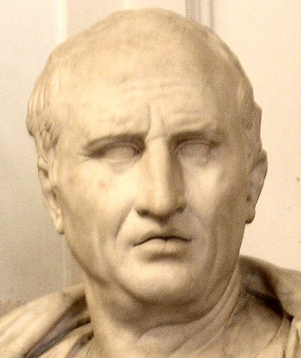
The Classical Oration
Devised by Greek and Roman rhetoricians nearly 2500 years ago for presenting cases in courts or making speeches to the senate.
Hail Cicero! Hail Aristotle! Hail Plato!
Cicero: Considered the greatest of ancient Roman Orators
Adapted from Everything’s an Argument by M. Gaines. Published 2010.

Slide 2
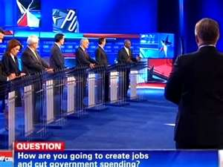
Still Relevant Today
Elements of classical oration or
classical argument still influence our
attitudes and perspectives today.
The use of context, assertions, evidence, logos, ethos, pathos, counterclaims, and analysis work together to persuade and influence others. Consider how well-formed arguments are infused into advertising,
political speeches and debates, even everyday communication.

Slide 3
CLASSICAL ORATION
Sequence of Six Parts
PART 1-Exordium (from Latin “ to urge forward”)
As you have no doubt heard, you need to “capture” the attention of your audience and win their “good will” before you begin to lay out your argument. This is called a “lead” in journalism. A lead can be a shocking statistic, a rhetorical question, or a bold fact that will introduce your topic and explain why it should matter. (Cross reference the verb “to exhort.”)
The Exordium can do one or more of the following:
Show importance/relevance of the issue.
Show how the issue affects the audience.
Show how the issue affects everyone.
Show how the issue affects the general good of the community.

Slide 4
PART 2-Narratio (from Latin “ to narrate or tell a story”):
Narratio: The narratio gives background information, or what is referred to as “context.”
It’s the “O” in SOAPSTONE. It relates events or conditions that have occurred in the past and which now provide the occasion/reason/context for the speech or essay. Narratio may also be a perfect place to describe the zeitgeist of the time period as well as perhaps delve into author exigence which is connected to the Occasion.
The narration should be brief, clear, and believable, thus furthering the justification of why the topic is important.
The narration can explain why something must be changed or why a certain way of thinking is not working.

Slide 5
PART 3-Partitio (from Latin “ to divide into parts)
Partitio: The partitio is the section of the speech or essay where the speaker or writer divides up, or “partitions” the subject into a claim (assertion) and its key, supporting arguments in the order they will be addressed.
Simply put, the Partitio is your Thesis Statement, which consisits of your claim plus 2-4 supporting arguments.
Once the Partitio is set, you can organize the rest of your speech/essay, fleshing it out with evidence, rhetorical appeals and logical analysis.
NOTE: The Exordium, Narratio, and Partitio can all be condensed and combined into one introduction paragraph when you are writing under a time limit.

Slide 6
PART 4-Confirmatio (from Latin “to confirm, verify, reinforce”)
Confirmatio: Here the speaker/writer offers detailed support for the claim, using factual evidence, analysis, and rhetorical appeals (logos, pathos, ethos).
Laying one part evidence with two parts analysis is the goal as you build/stack your argument paragraphs.

Slide 7
PART 5-Refutatio (from Latin “to refute”)
Refutatio: The speaker/writer acknowledges that the other side has some valid points and then refutes opposing claims, arguments and/or evidence
Question: why do you want to acknowledge that the other side’s arguments have merit? Wouldn’t that just weaken your own arguments?

Slide 8
PART 6-Peroratio (from Latin “to conclude an oration”)
Peroratio: The speaker/writer summarizes the case by circling back to the thesis statement and reiterating the claim and supporting arguments.
The speaker/writer should also use some kind of closing strategy to leave the hearers/readers with a strong final impression.
Closing strategies can be a call to action/change, a rhetorical question, a bold statement, or any other closer that galvanizes your position and point of view.

Slide 9
Apply your understanding of the
Classical Oration argument model with the assignment below:
Text: The Declaration of Independence
Using colored pencils, identify and label the different parts of the Classical Oration argument model in the text.
Explain in the margins why you labeled the parts as you did to demonstrate your understanding of the Classical Oration argument model.

